Slide 1


ECEN 403
Final Presentation
Matrix 1 / “Scooter Juice”
Connor Cottongame
John Dusterhoff
Blake Hallam
Oscar Rubio
TA: Hailey Ward
Sponsor: Prof Prasad Enjeti

Slide 2

Project Summary - Problem Statement
Scooter use external AC-DC rectification blocks to charge its battery
This creates bulky charging blocks and cables that are inconvenient to carry around and take up space.
Why it is wasteful
The charger’s rectifier/converter block and the motor inverter have near identical parts (MOSFETs, gate drivers, controller).
Scooter owners carry a wall brick around. If you lose it, forget it, or it breaks the scooter is left useless without purchasing a new one.
The charging stage and motor running occur independently from each other
Our goal: one set of power electronics on board that does both, drives the motor when using the scooter, and rectifes grid power at wall when charging the battery
WITH IOBC
One set of electronics, two modes
■ Drive mode: the inverter drives the motor (same as before).
■ Charge mode: a matrix converter + HF transformer on the primary side feed the same inverter running as a rectifier.

Slide 3
Project Summary - Our Solution
Integrated On Board Charger
Reuse the motor inverter as a battery-side rectifier; add just the primary stage needed to make that safe from the grid.
A matrix primary feeding the inverter through a high-frequency transformer is the only topology that meets all of these goals at once:
Galvanic isolation from the grid
A 100 kHz ferrite transformer keeps the battery and rider electrically separated from 120 V mains and it stays small and light. A 60 Hz line-frequency transformer would add pounds and volume.
No bulky DC-link capacitor
Power flows straight through matrix → transformer → inverter without an electrolytic storage bank.
Low conduction loss at 250 W
Triple Phase Shift (TPS) modulation (d₁, d₂, δ) picks between six operating regions on every switching cycle, choosing the one that minimizes RMS inductor current.
Design targets
INPUT
120 Vrms, 60 Hz
OUTPUT
36V DC nominal (24–48 V)
SWITCHING FREQUENCY
100 kHz
TOPOLOGY
DAB with HF transformer
CONTROLLER
TI C2000 F28P650DK9
Reference: Huang, Wang, Liu & Enjeti, “A New Integrated Onboard Battery Charger For Electric Scooters,” INTELEC 2024.
Notes:
Cloud server and database

Slide 4
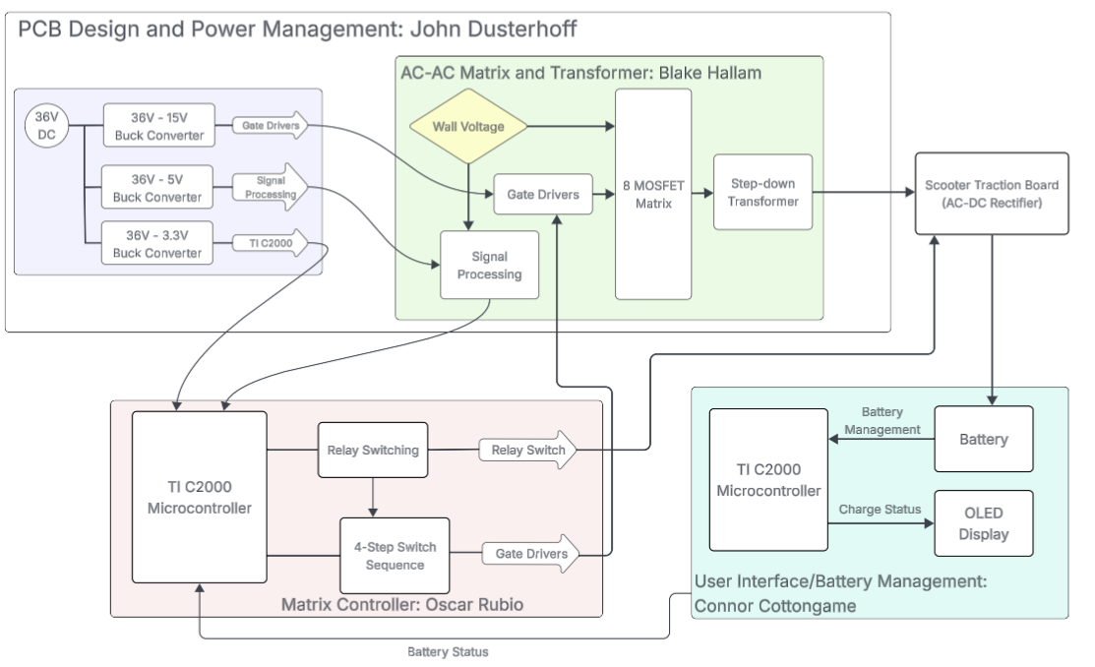
System Overview
Notes:
Cloud server and database

Slide 5
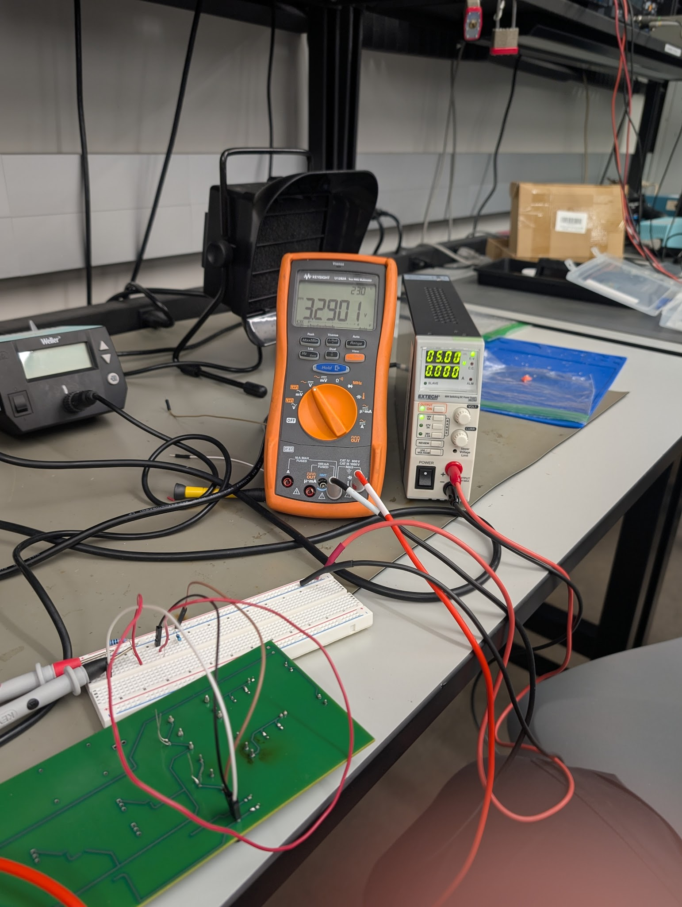
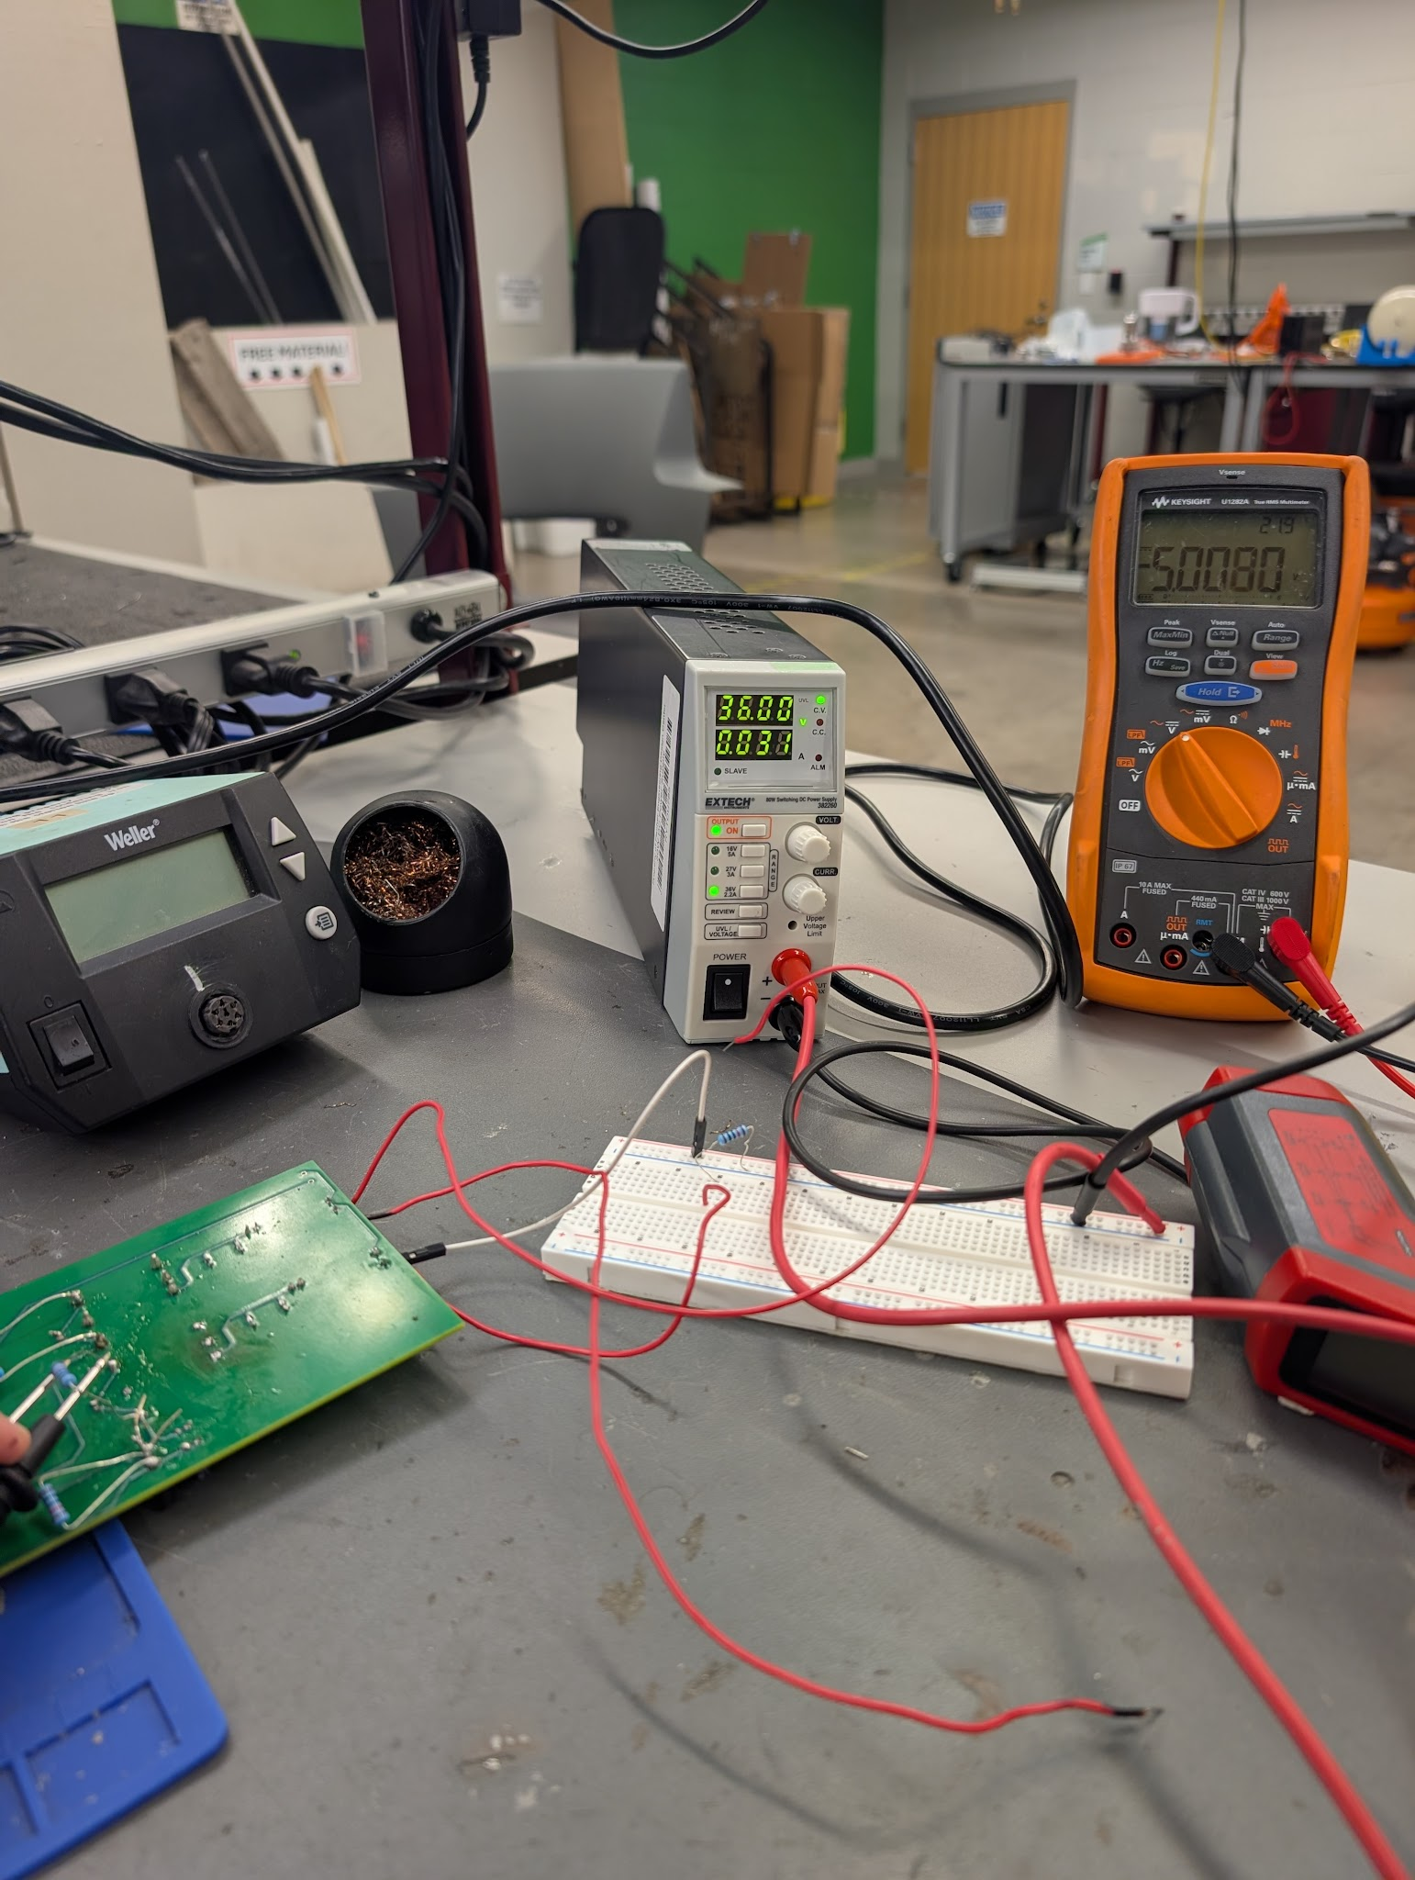
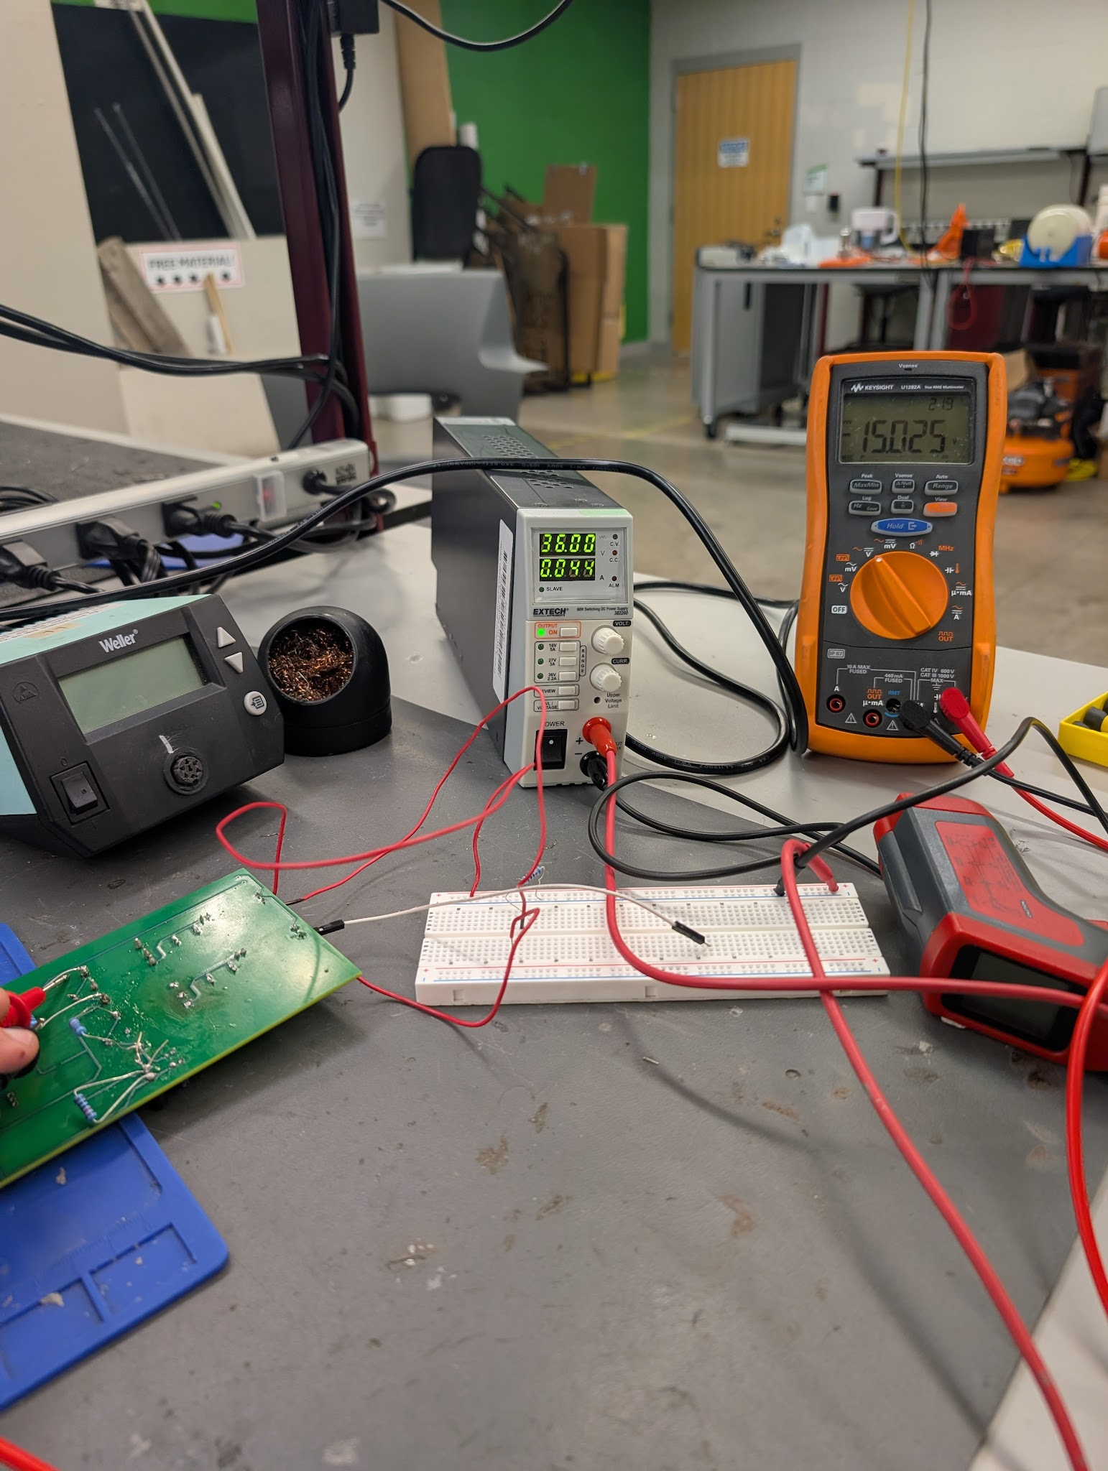
Buck Converter and PCB Design
John Dusterhoff

Slide 6
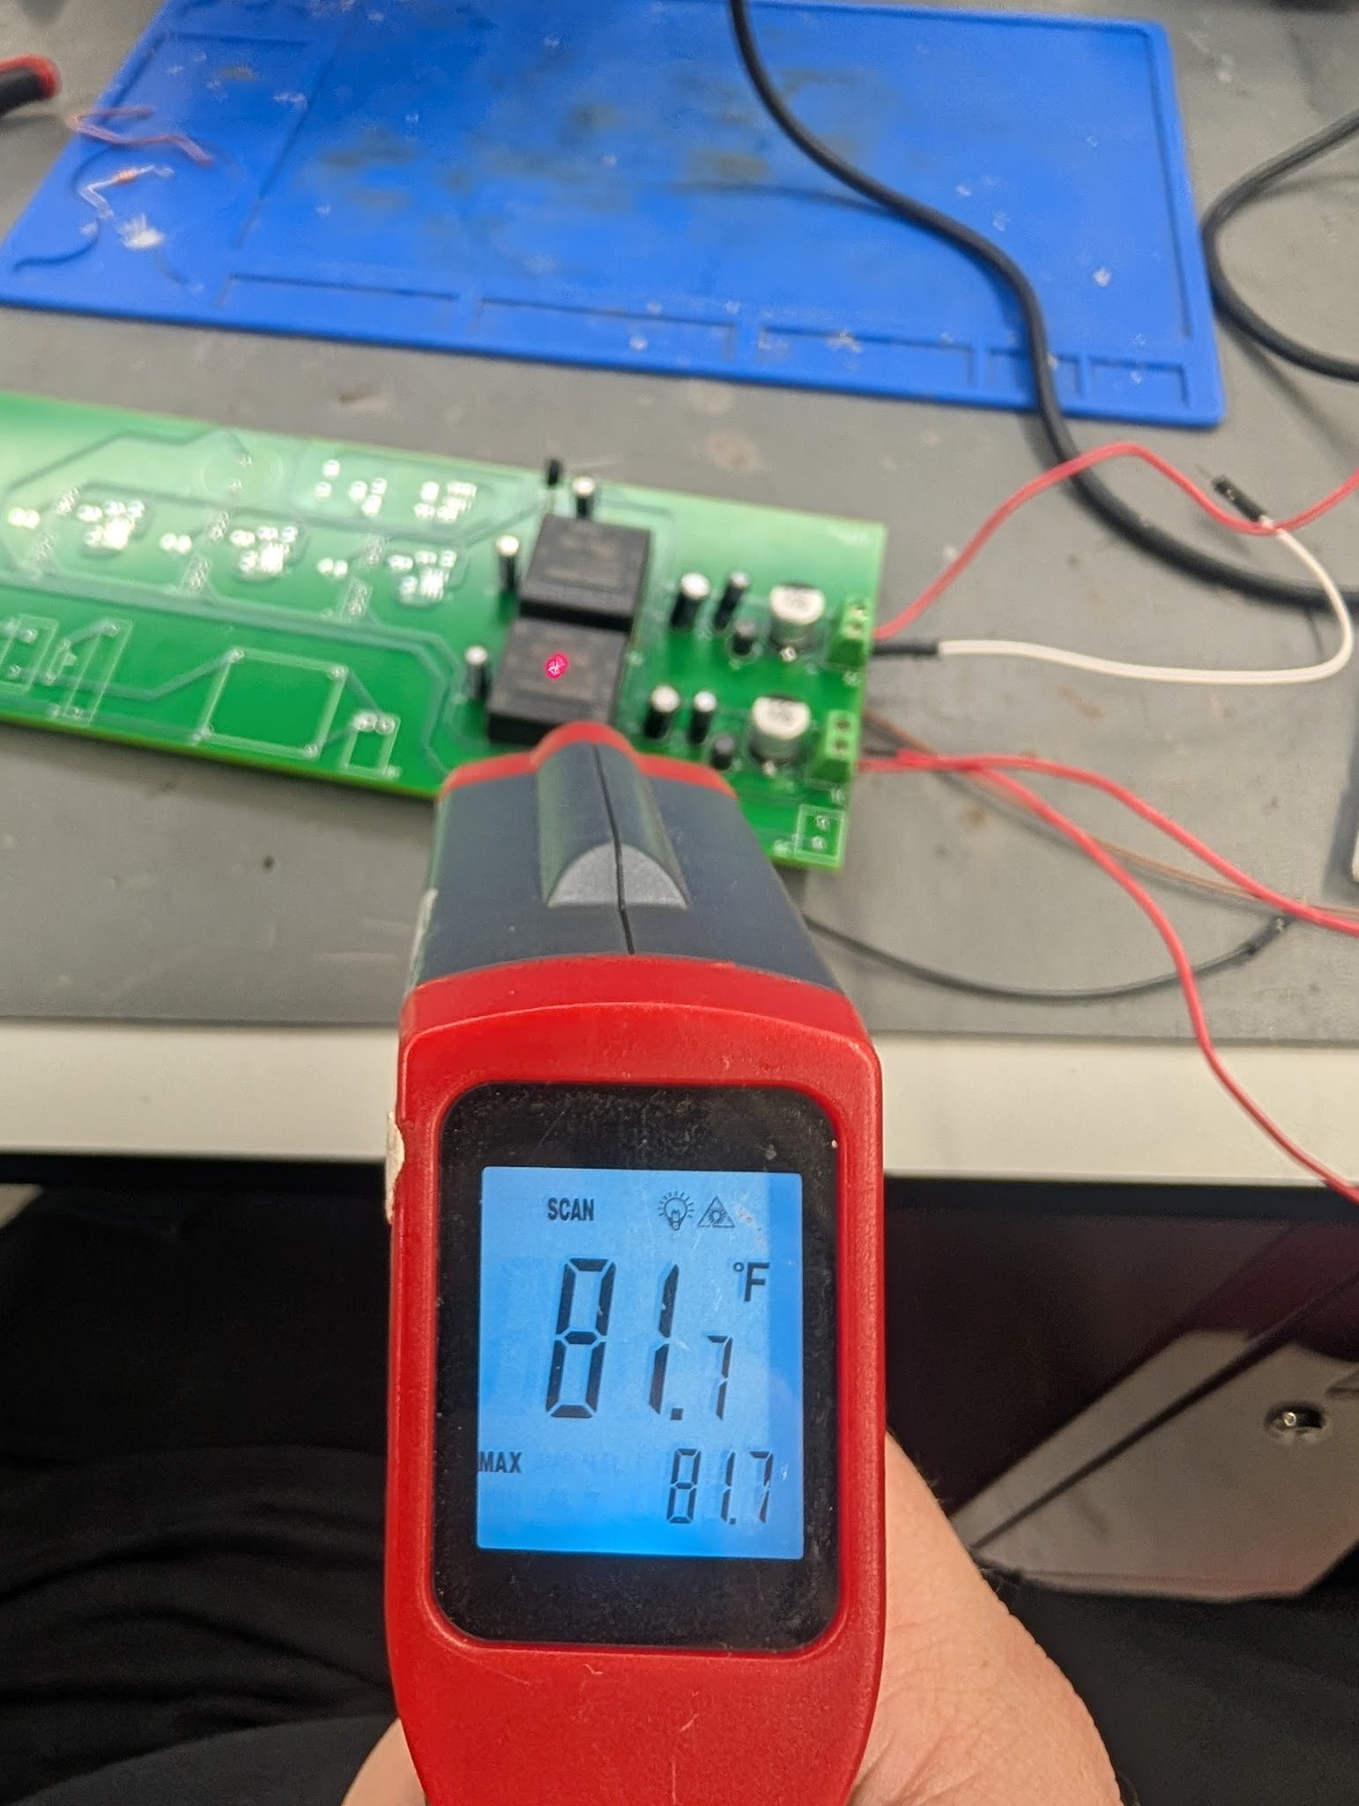
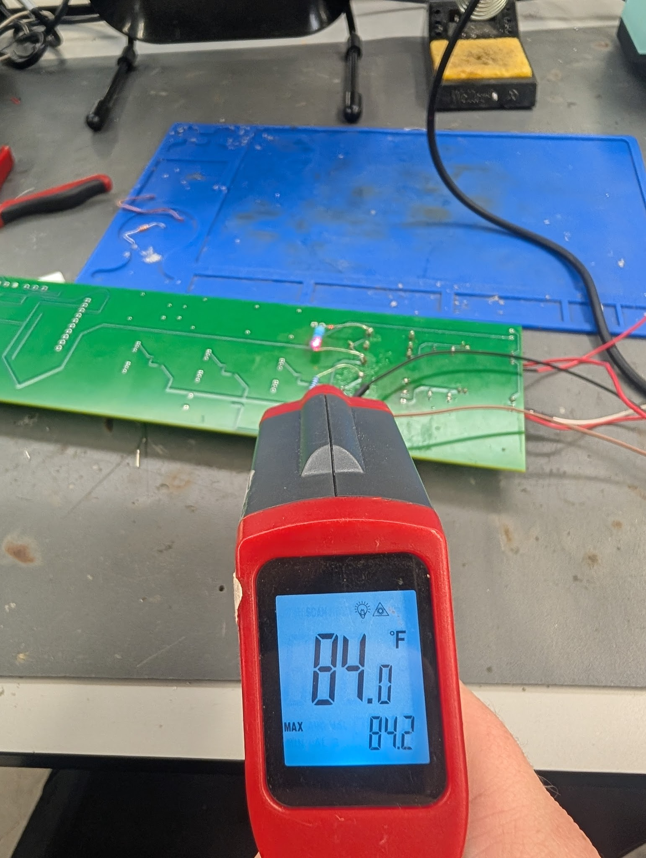
Buck Converter and PCB Design
John Dusterhoff
15V Thermal Tests

Slide 7
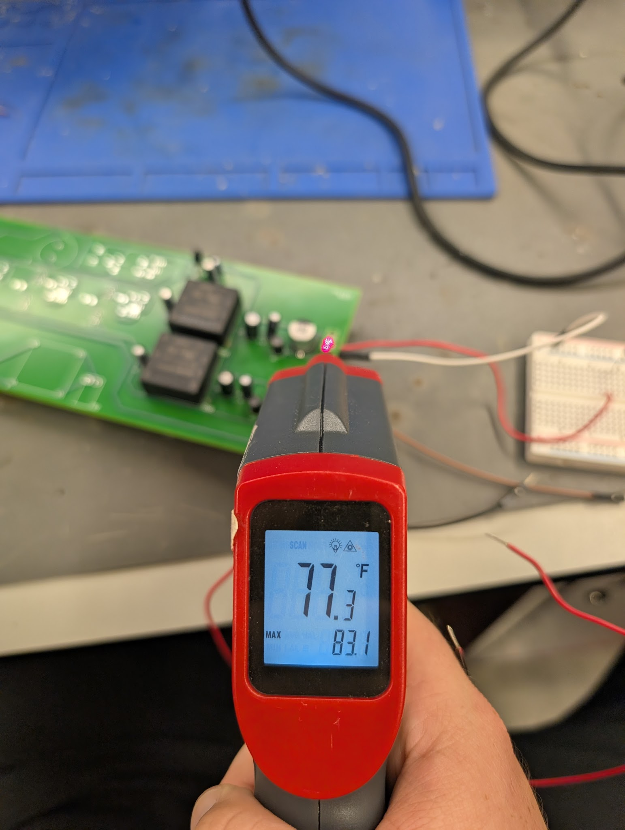
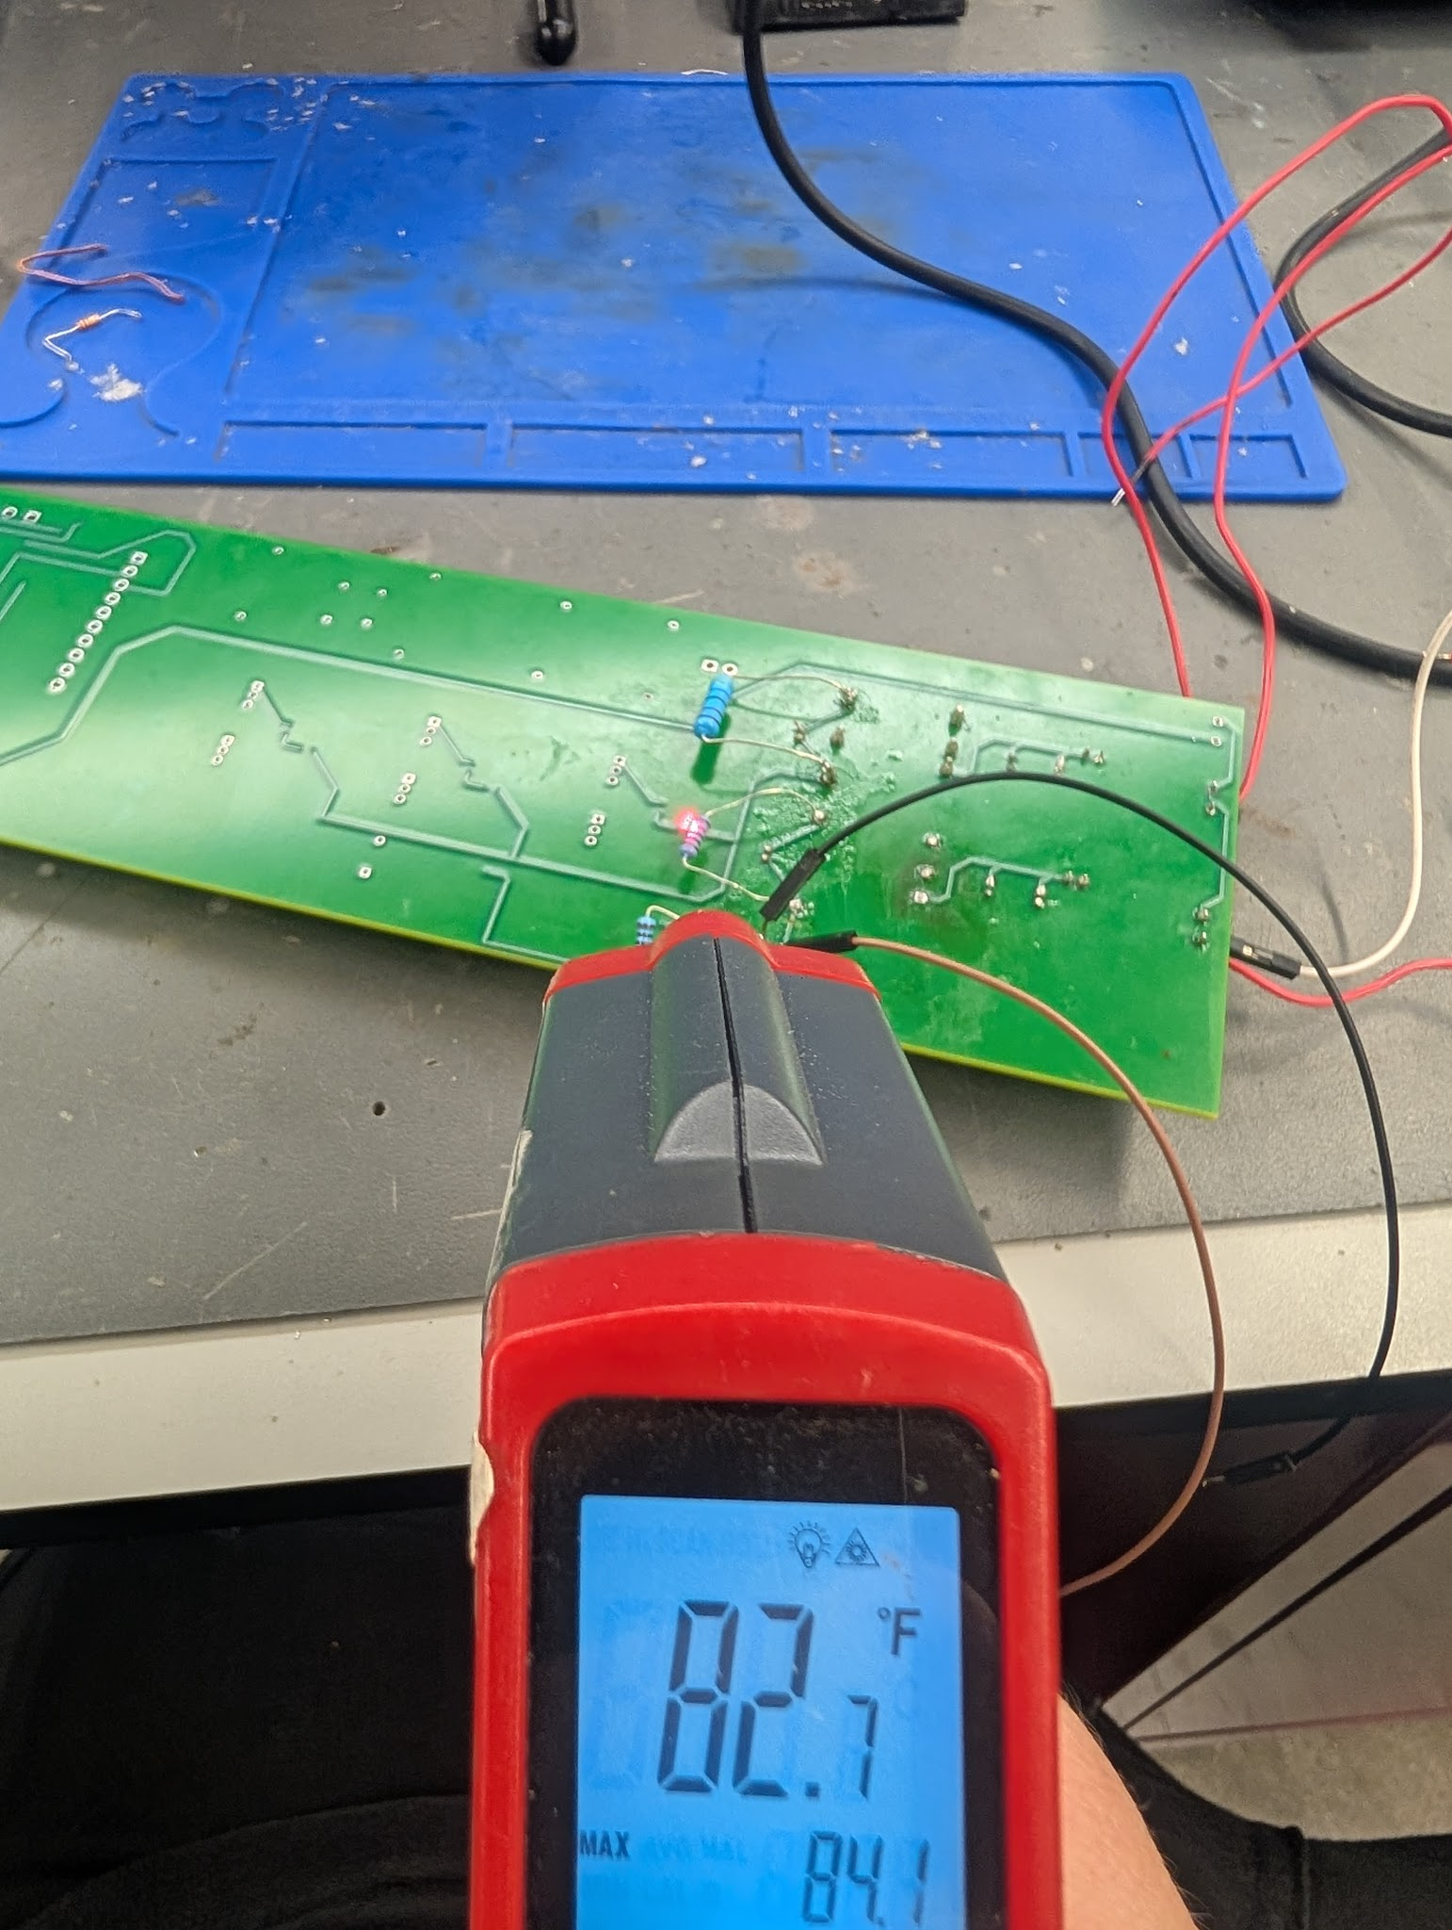
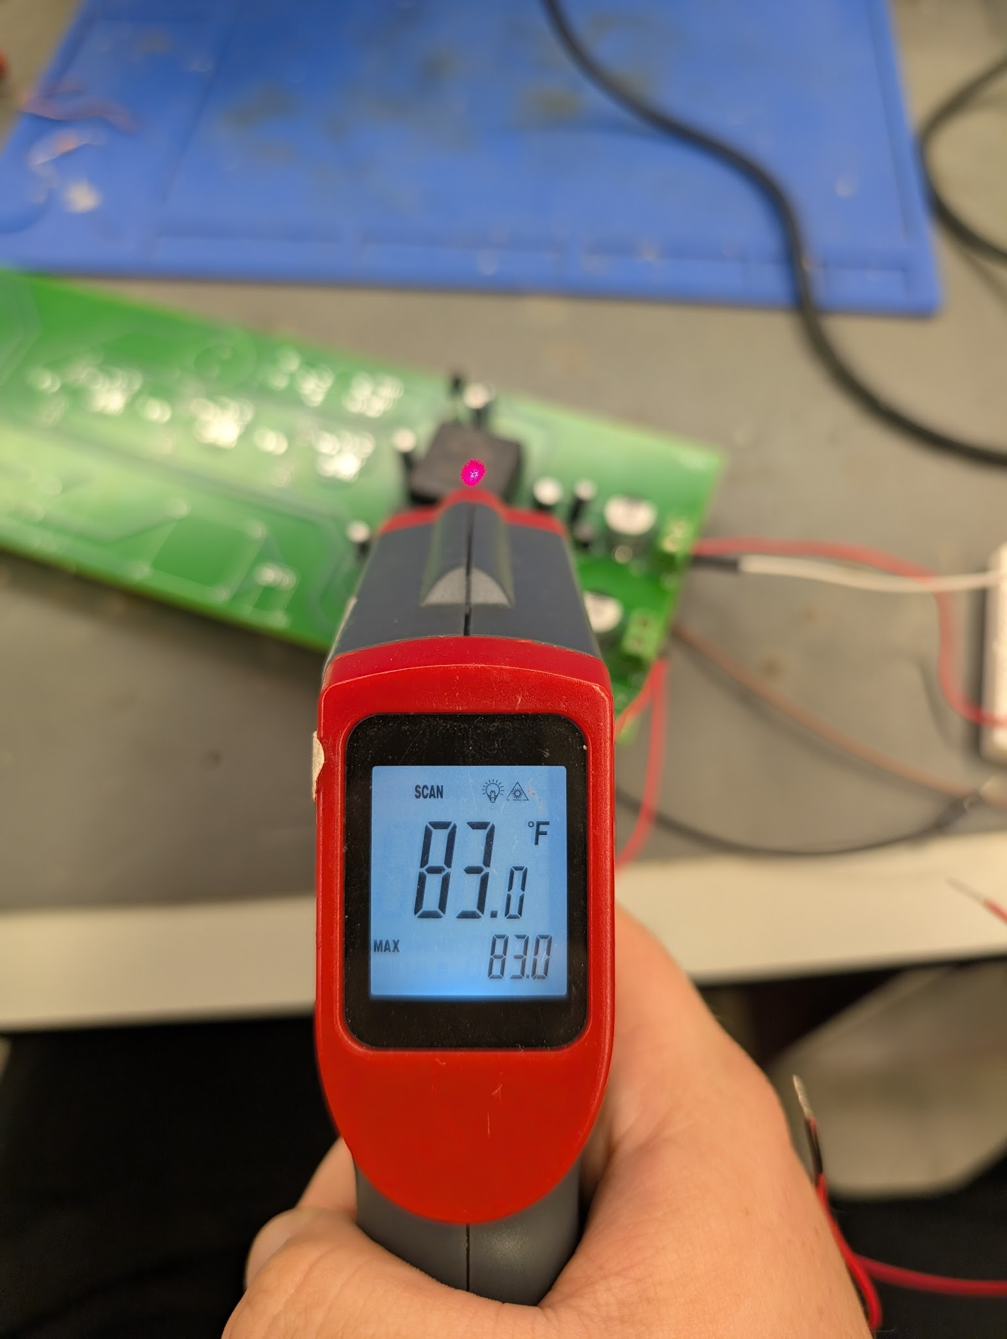
Buck Converter and PCB Design
John Dusterhoff
5V Thermal Tests

Slide 8
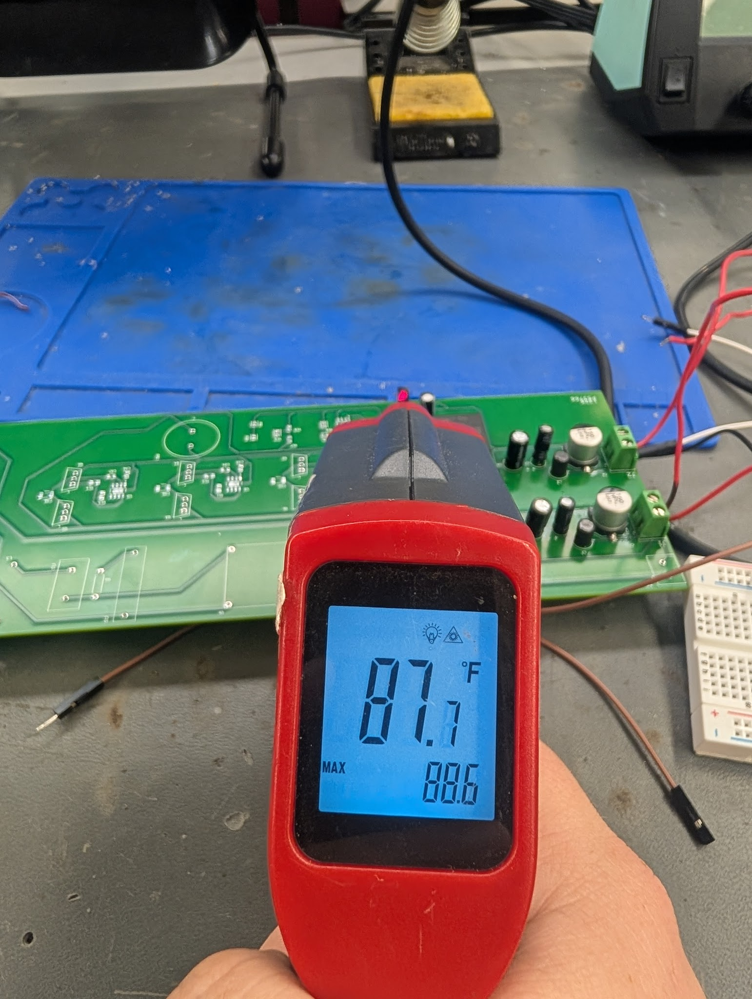
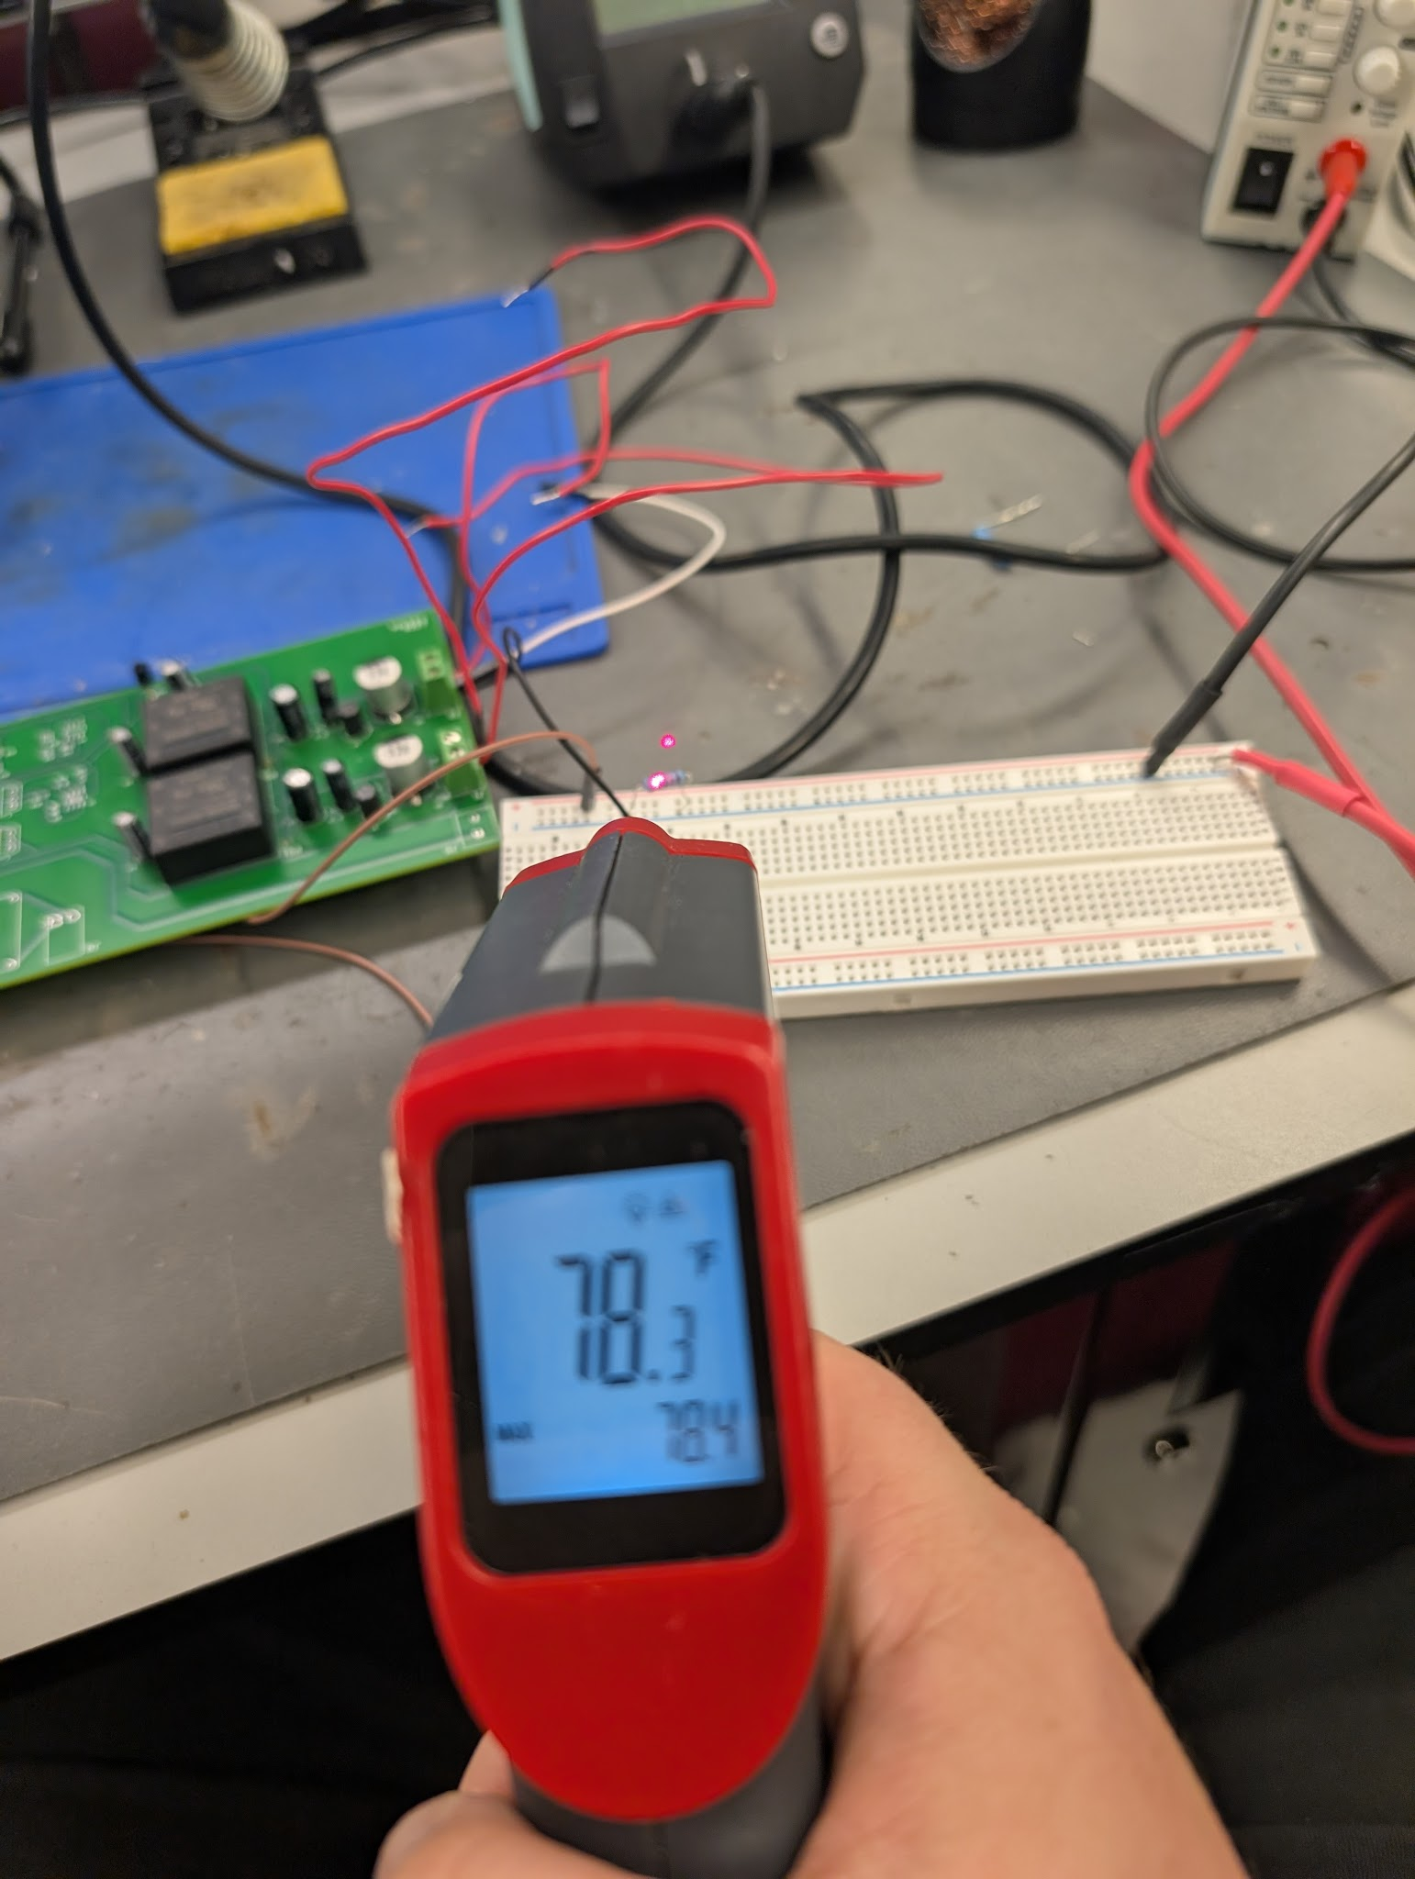
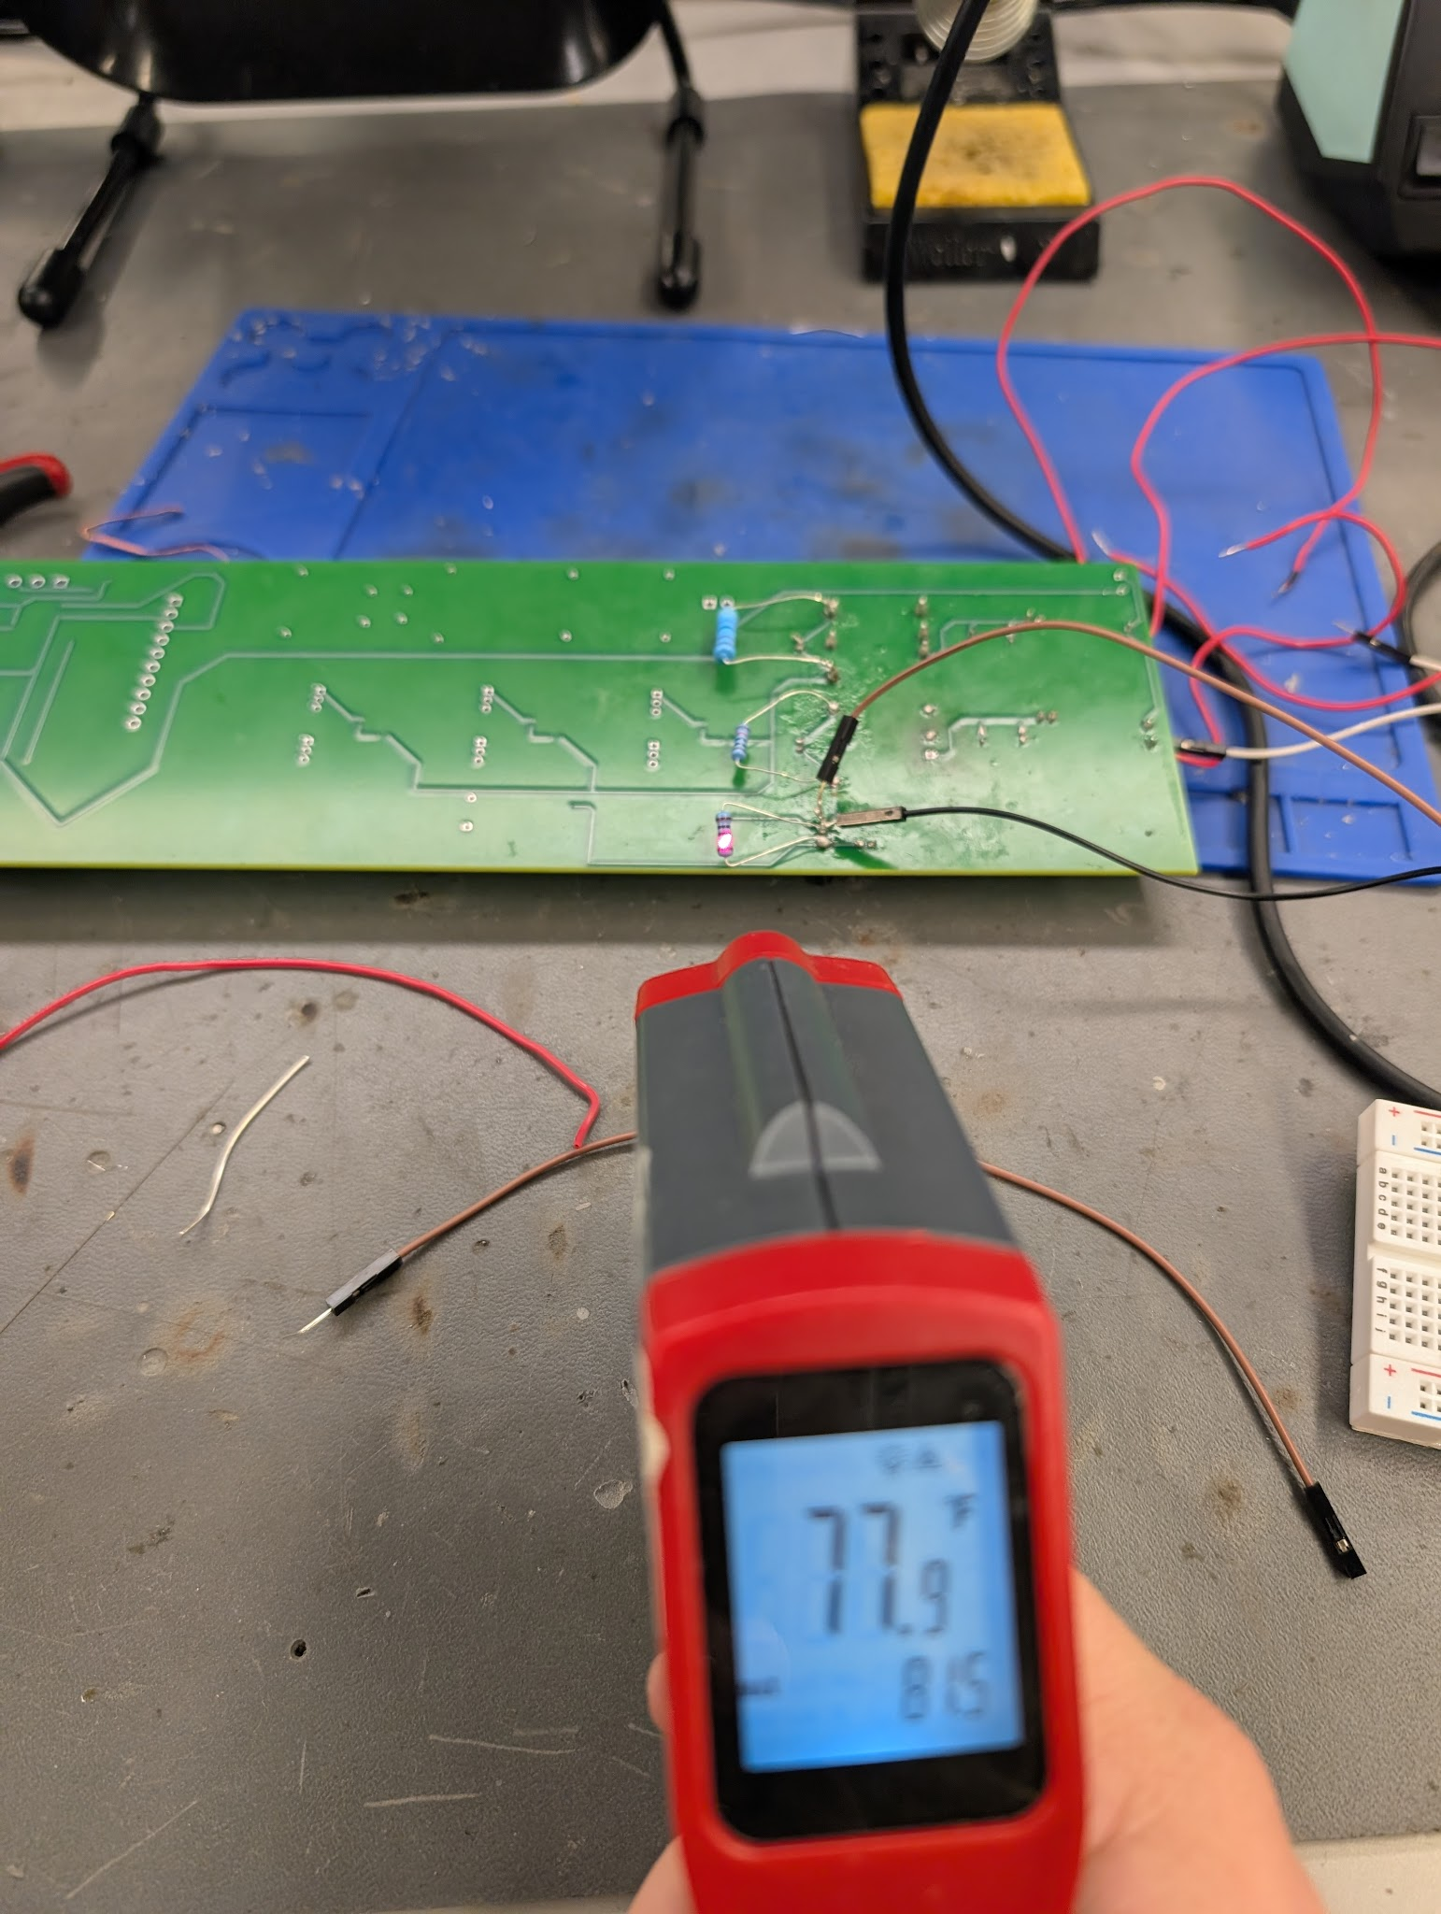
Buck Converter and PCB Design
John Dusterhoff
3.3V Thermal Tests

Slide 9
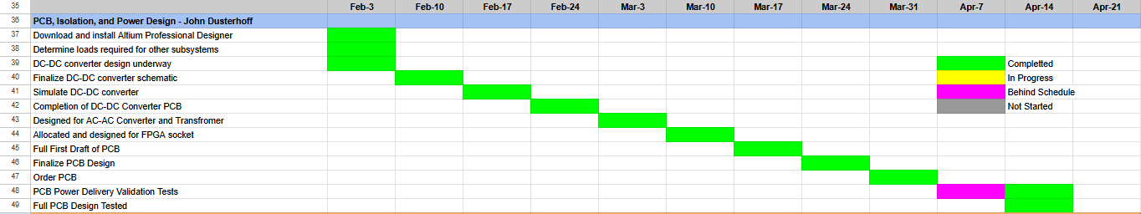
Buck Converter and PCB Design - Execution Plan
John Dusterhoff

Slide 10
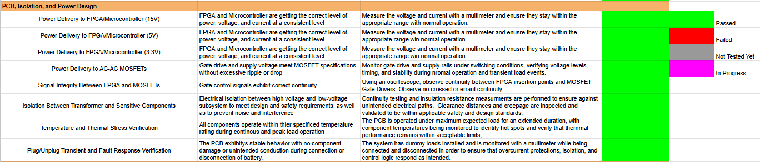
Buck Converter and PCB Design - Validation Plan
John Dusterhoff

Slide 11
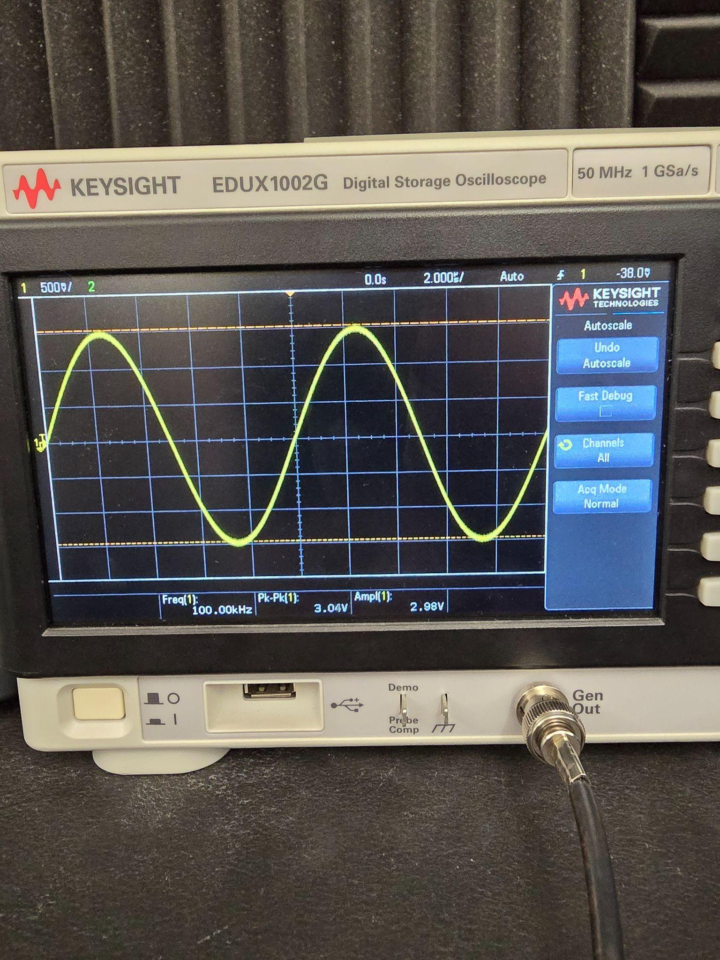
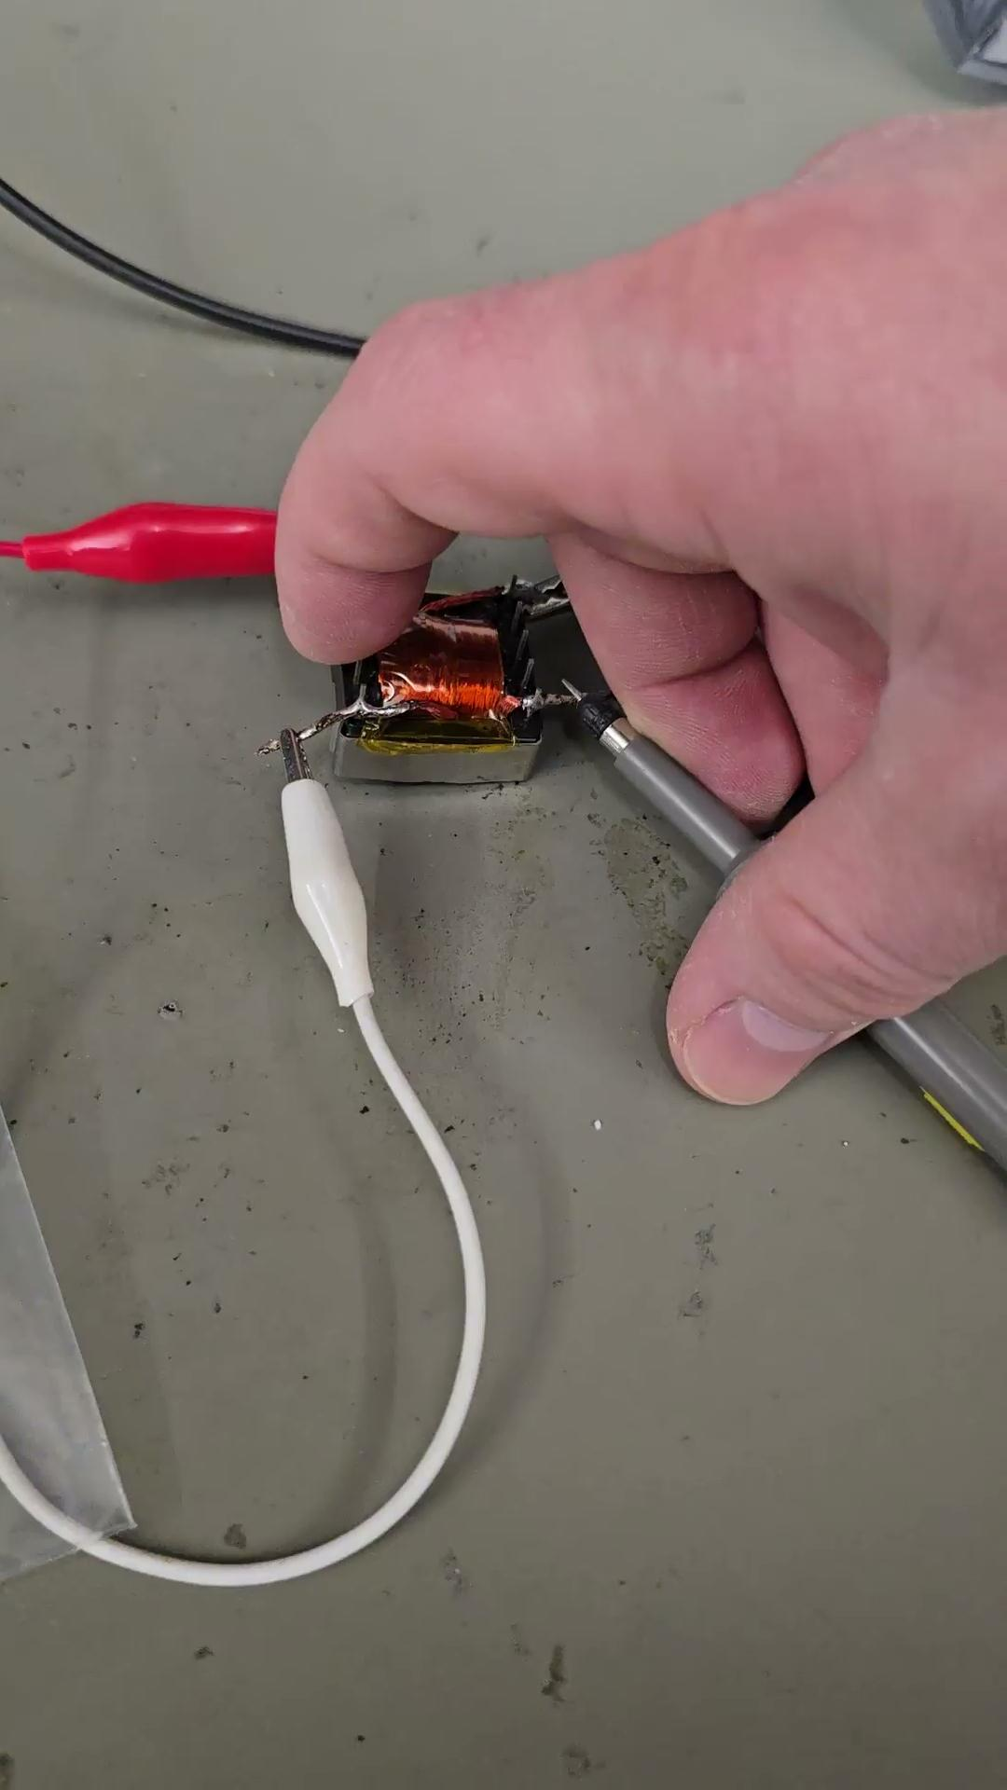
Matrix Analog System - Execution status
Blake Hallam

Slide 12
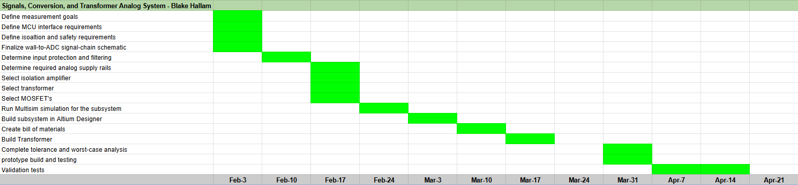
Matrix Analog System - Execution status
Blake Hallam

Slide 13
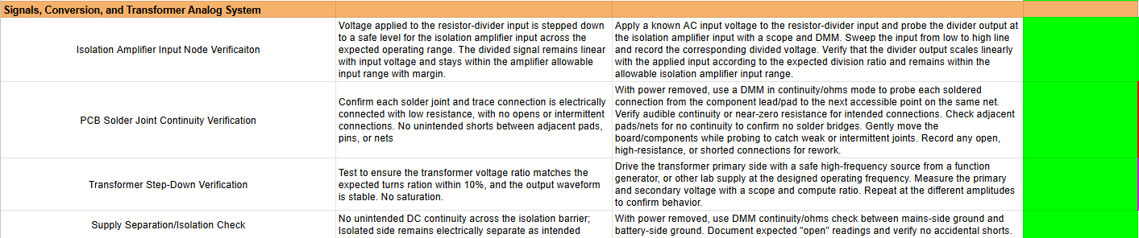
Matrix Analog System - Validation Status
Blake Hallam

Slide 14
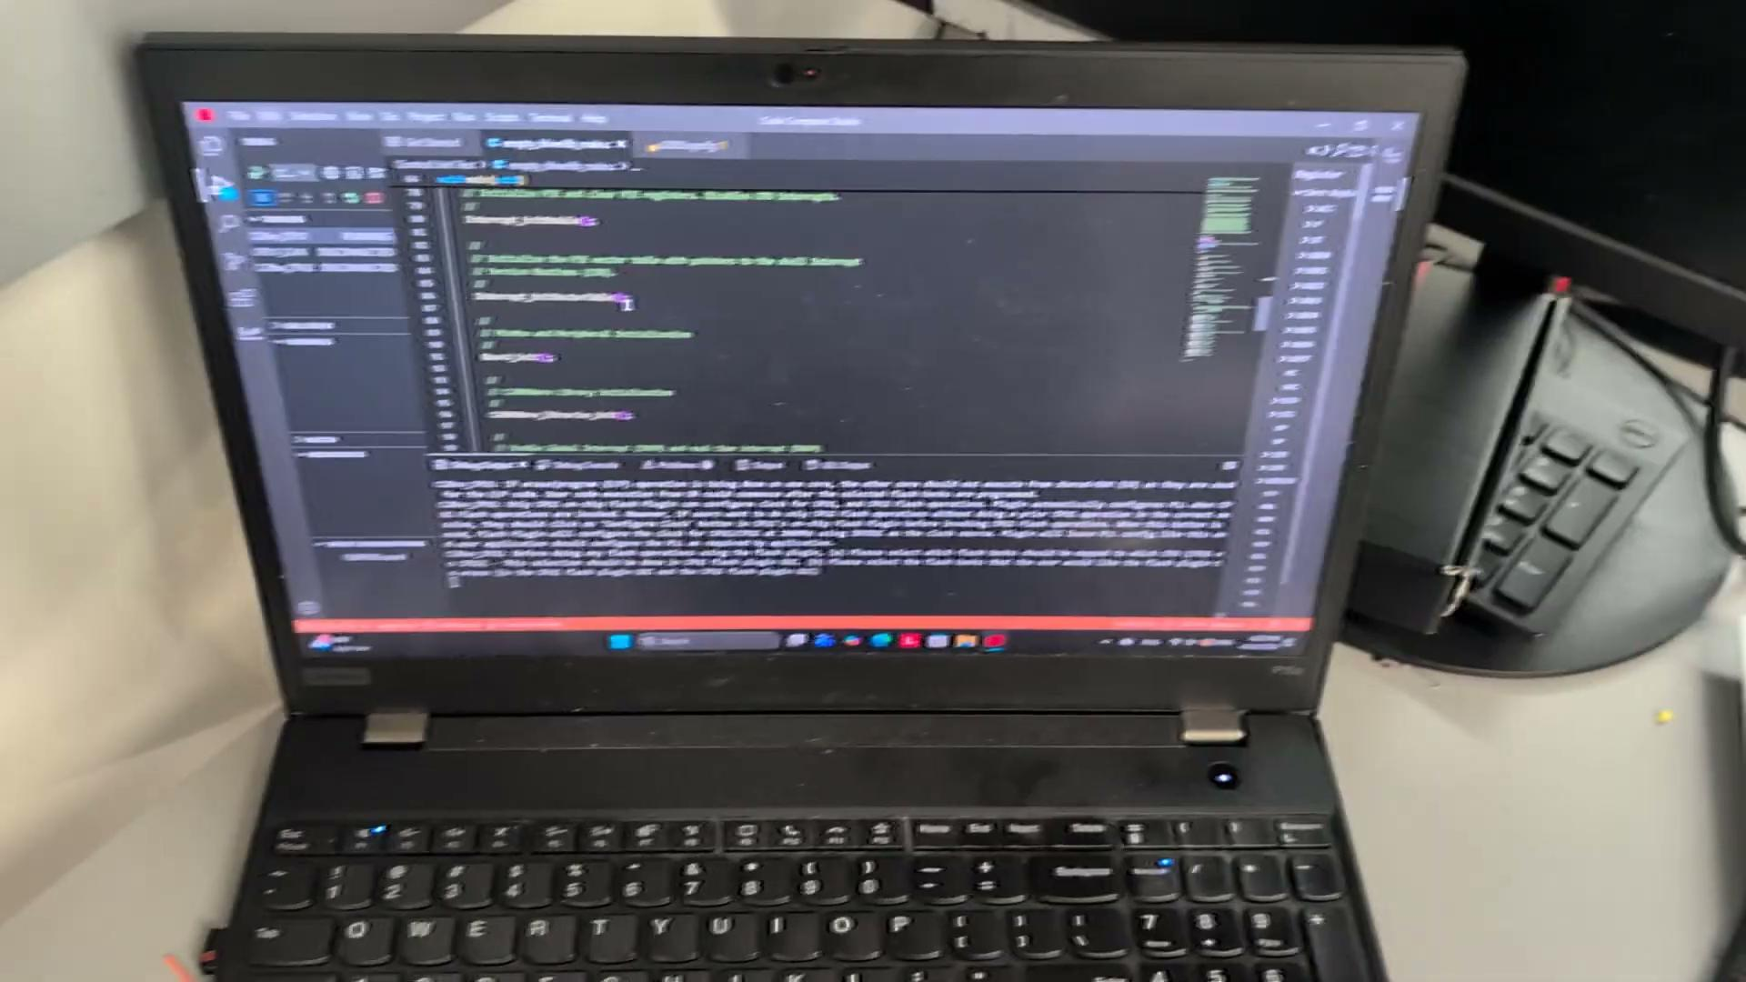
Matrix Control System
Oscar Rubio

Slide 15
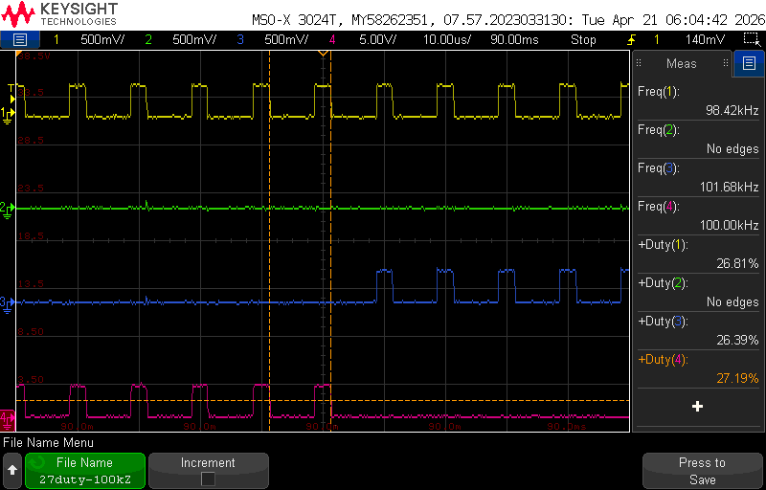
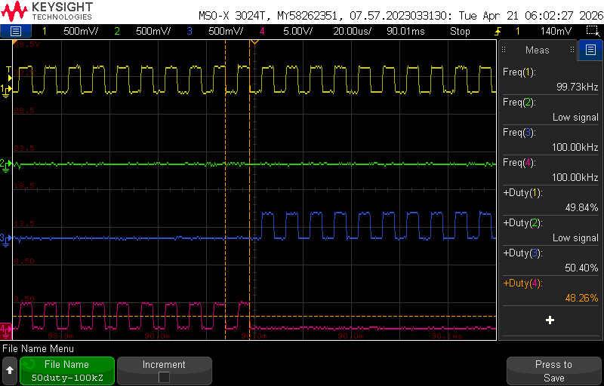
Matrix Control System
Oscar Rubio
Zoomed in picture of Duty Cycle = 27% and
Switching Frequency = 100 kHz
Zoomed in picture of Duty Cycle = 50% and
Switching Frequency = 100 kHz

Slide 16
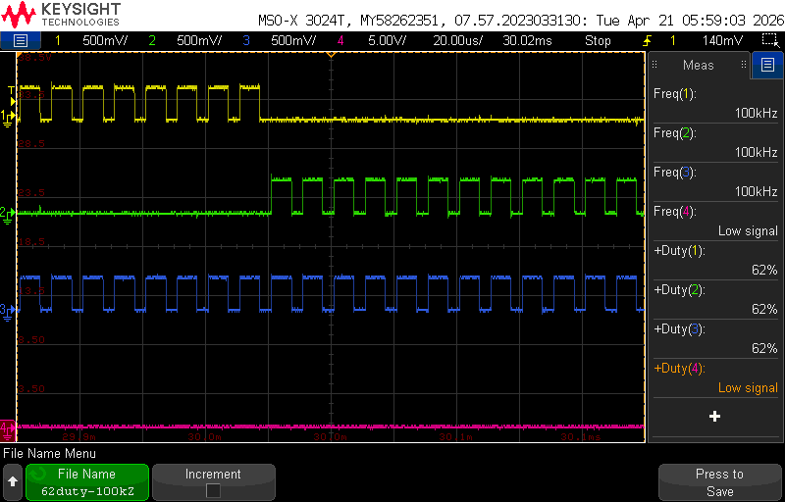
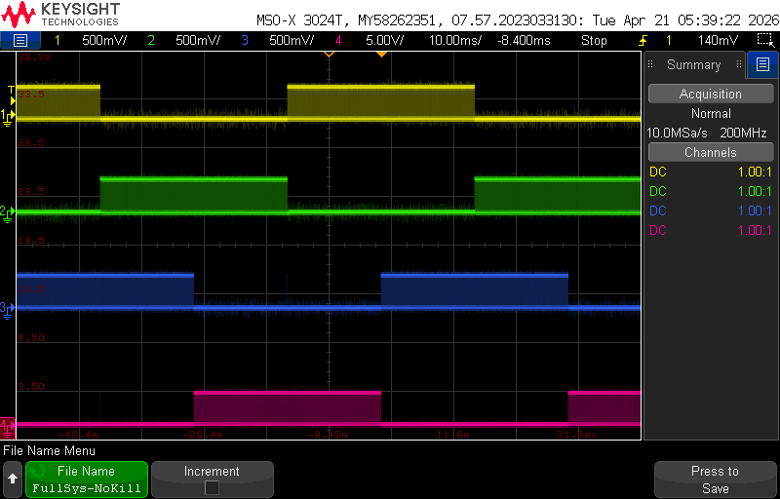
Matrix Control System
Oscar Rubio
Zoomed in picture of Duty Cycle = 62% and
Switching Frequency = 100 kHz
Image of the Full System: No Kill Sequence Activated

Slide 17
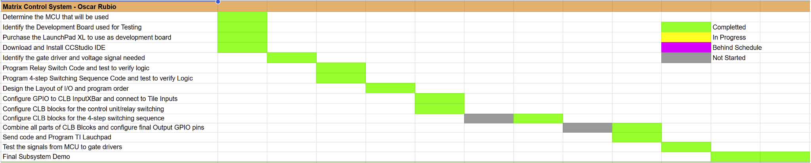
Matrix Control System – Execution Status
Oscar Rubio

Slide 18
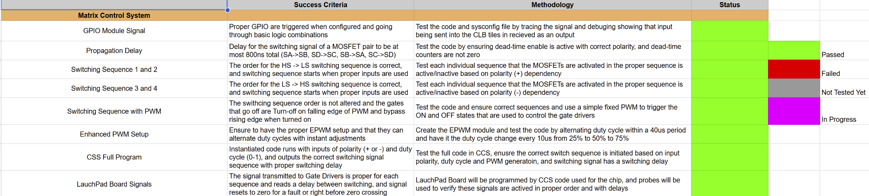
Matrix Control System – Validation Status
Oscar Rubio

